Slide 1
Effects of Race and Sex on Income
Sindhu Srivats, Dustin Tran, Anna Yang
CSC480 - AI
Notes:
sindhu

Slide 2
Motivation
Bias in AI systems can appear in different ways
Discrimination via biased settings in economic settings
Exploring any quantitative effects with ML algorithms
This domain is interesting because discrimination likely harms people’s income
Potential applications for this domain:
System to predict potential income brackets based on available information
Goals:
Determining most accurate algorithm; best combination of parameters
Use of knowledge of course topics:
Agents, various models/methods
Notes:
Sindhu
Racism in American healthcare
Sexism in societal views
Discrimination in Amazon’s hiring

Slide 3
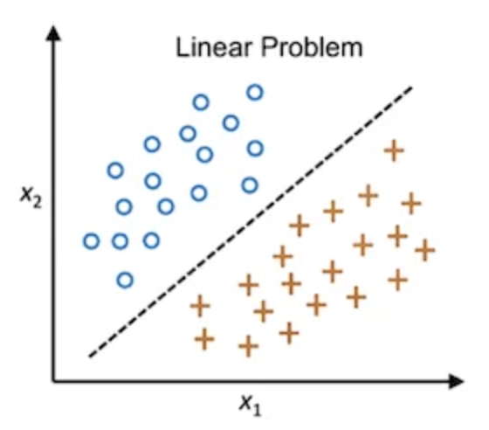
Background — Linear classifier (logistic regression)
Binary classification system
Each data point gets 0 or 1 based on a linear model

Slide 4
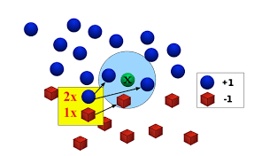
Background — K-Nearest Neighbors
Proximity-based classifier, each data point belongs to the group the majority of k nearest data points are part of

Slide 5
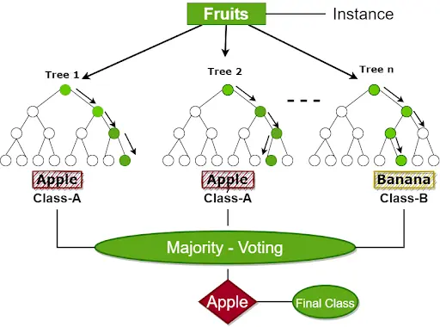
Background — Random Forest
Majority of 1+ decision trees’ results to classify a data point
Not all decision trees use the same features

Slide 6
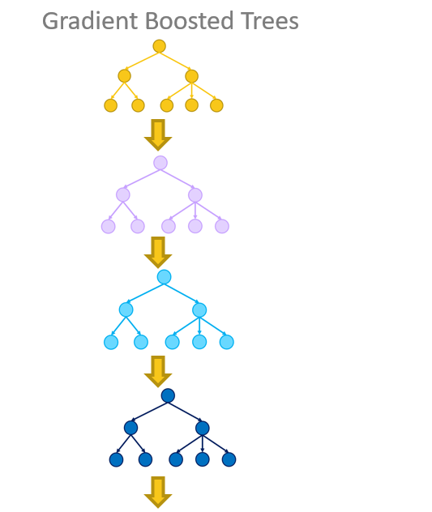
Background — Gradient Boosting
Classification of each prior iteration is used in the current iteration’s prediction

Slide 7
Implementation
Main inputs of the system:
‘Adult.data’ 1994 Census dataset from UCI’s ML Repository
Combinations of 14 parameters
Configurations for algorithm
Main outputs of the system:
Accuracy score
Main components:
Scikit-learn models
Notes:
Sindhu
Racism in American healthcare
Sexism in societal views
Discrimination in Amazon’s hiring

Slide 8
Starting Point - Dataset
Extracted from the 1994 Census database by Barry Becker
Donated to UCI’s Machine Learning Repository on May 1, 1996
Contains 48,842 instances with attributes:
Age
Workclass
fnlwgt (final weight)
education
education-num
marital-status
occupation
relationship
race
sex
capital-gain
capital-loss
hours-per-week
native-country
Notes:
sindhu

Slide 9
Starting Point - Related Work
Predicting if Income Levels exceed $50,000 a year (UCSD) https://cseweb.ucsd.edu/classes/sp15/cse190-c/reports/sp15/048.pdf
Dataset:
1994 Census database by Barry Becker
Algorithms used:
Naive Bayes
Logistic Regression
Decision Tree (Classification and Regression Trees)
Techniques:
Select Training and Testing Datasets
Removal of certain Samples and Features
Conclusion:
‘age’, ‘education’, ‘hours per week’, ‘occupation’, ‘sex’ were the most useful features
Decision Tree had highest accuracy/least error
Notes:
Anna

Slide 10
Starting Point - Related Work (cont.)
Modifications made:
Algorithms used:
Linear Classifier (logistic regression)
K-Nearest Neighbors
Random Forest
Gradient Boosting
Inclusion of all features from the dataset
Random selection of Training and Testing data

Slide 11
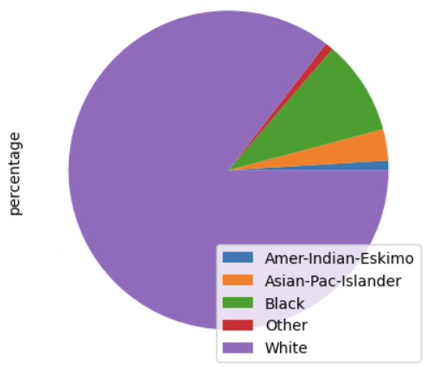
Data Analysis: Racial Distribution
85%
1%
10%
3%
1%

Slide 12
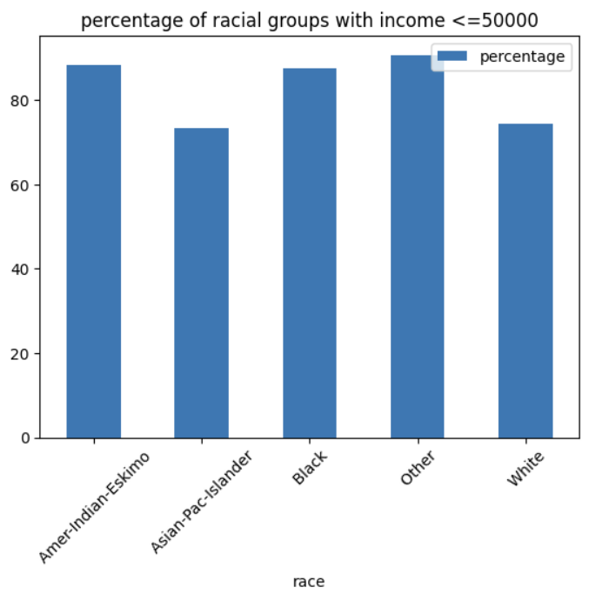
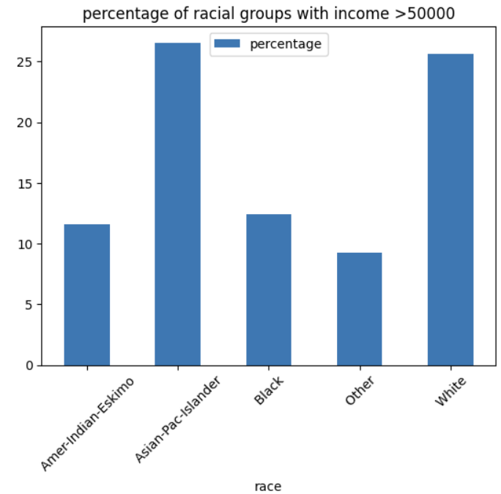
Data Analysis: Race and Income
88.4%
87.6%
90.8%
26.6%
25.6%
73.4%
74.4%
11.6%
12.4%
9.2%

Slide 13
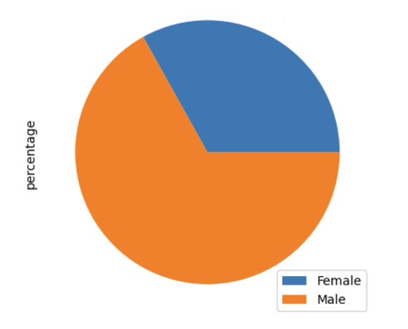
Data Analysis: Sex Distribution
33%
67%

Slide 14
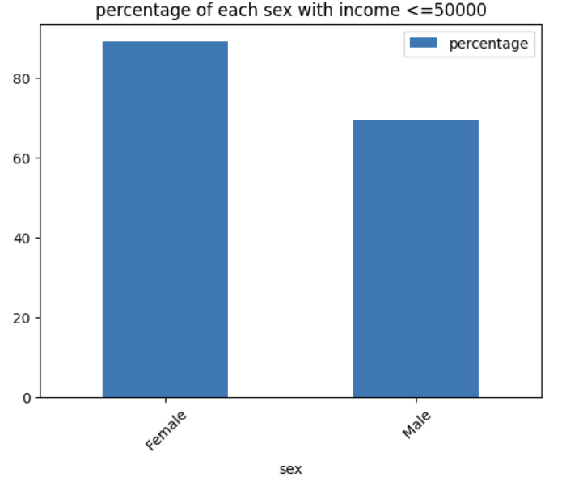
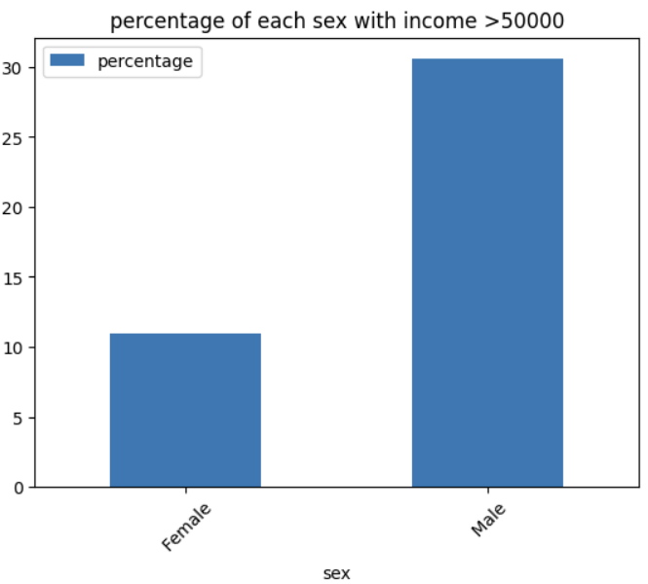
Data Analysis: Sex and Income
89.1%
30.6%
69.4%
10.9%

Slide 15
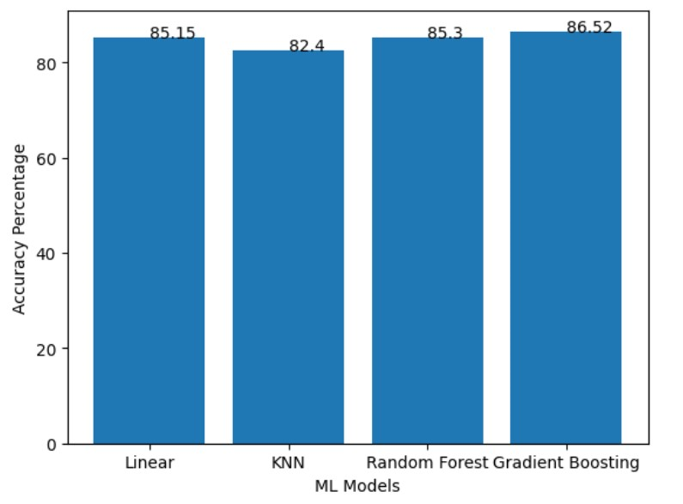
Results — Data from Models
Baseline accuracy is about 75.9%
Accuracy = Number of correct predictions / Total number of predictions.
Using all attributes, the Gradient Boosting algorithm appears to give the highest accuracy at 86.52%.

Slide 16
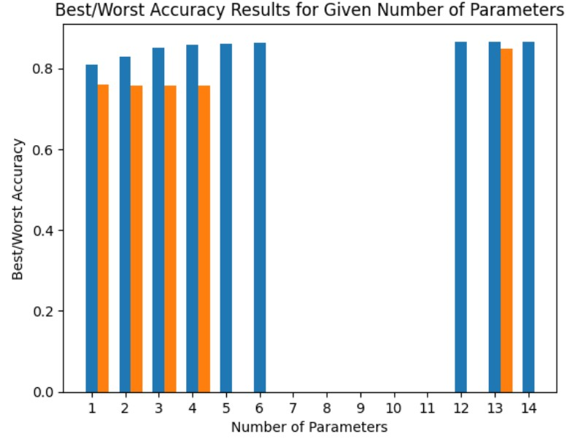
Results — Data from Models (Continued)
Best obtainable accuracy is 86.62% with 12 parameters
Diminishing returns on improvement after 5 or 6 parameters
0.5% improvement
‘Capital-gains’ appear to be the most valuable parameter

Slide 17
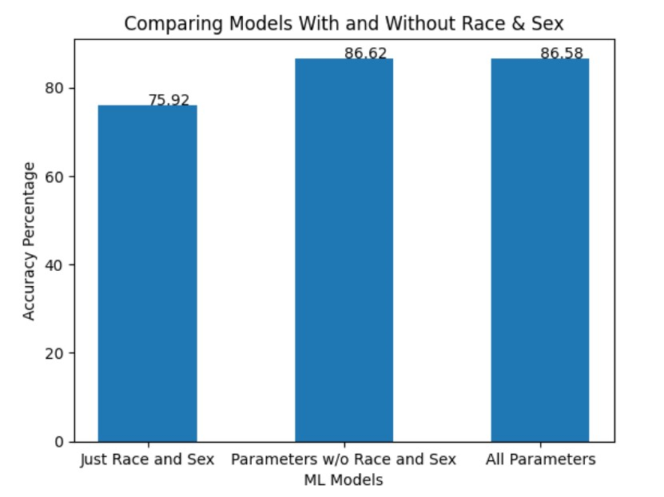
Results — Data from Models (Continued)
Race and Sex as the sole parameters for the model perform badly
82.9% best; 75.7% worst
No major change in accuracy if you add/remove race and sex

Slide 18
Conclusion
Gradient boosting model had 86.62% accuracy
12 parameters without sex and race
Data analysis indicates that race and sex were generally not the most impactful in the ML models for accuracy

Slide 19
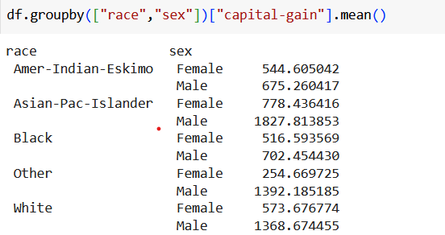
Conclusion(cont.)
Does this mean that sex and race do not play a major role in income?
No. There are definitely nuances to consider that are not covered by our project in addition to the relationship between parameters i.e. capital gains and income

Slide 20
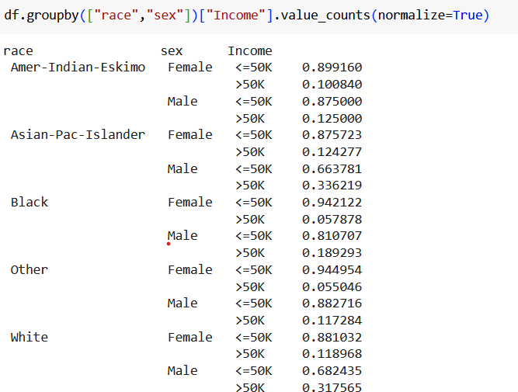
Conclusion(cont.)

Slide 21
Difficulties/Issues: Now and From Before
Addressing previous issues:
Accuracy scores
~85% accuracy no matter what combination of parameters
~75% accuracy using any single parameter
Inefficient workflow
No built-in functionality to test removal of variables
Treating each observational unit as an individual
Improper handling of the “fnlwgt” parameter
Notes:
dustin

Slide 22
Thank you for listening!
Questions?

